Slide 1
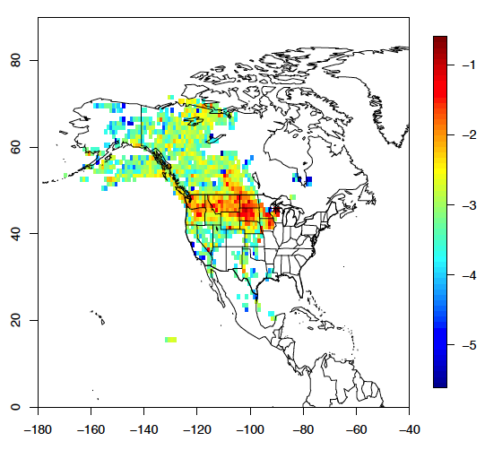
Regional Inverse Modeling in North and South America for the NASA Carbon Monitoring System
Arlyn Andrews (NOAA/ESRL), John Miller (NOAA/ESRL, CIRES),
Thomas Nehrkorn and Marikate Mountain (AER), Anna Michalak (CIS), Christopher O’Dell (CSU)
Merger of Andrews 2012 and Miller 2012 projects – regional CO₂ inverse modeling for North and South America using in situ and remote sensing data
Focus on 2015, first calendar year with OCO-2 data
Continue to refine flux estimation strategy – ensembles of inverse model calculations to test sensitivity to prior flux errors, assumed prior error structure, data weighting approaches, boundary values, etc.
Comparison of optimized fluxes with global CMS flux products
WRF model domain for North America
Typical STILT-WRF footprint

Slide 2
July 2010 Cumulative Sensitivity to Surface Flux for In Situ (Flask and Continuous) and ACOS GOSAT quality controlled data
Number of GOSAT observations is relatively low and sensitivity to surface fluxes is much lower than for in situ data – OCO-2 will have many more cloud-free scenes
Increased sensitivity for column data may be achieved by extending domain further over the Atlantic

Slide 3
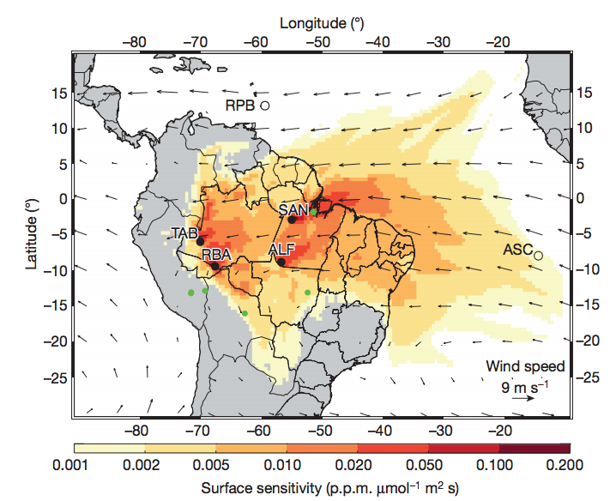
⬅Sensitivity of in situ CO₂ aircraft measurements to surface fluxes (Gatti et al., 2014).
Comparison of observed and NASA CMS v3.3 simulated profiles for the site Tabatinga in the Brazilian Amazon showing a large bias during the wet season (DJF) with smaller but significant difference during the dry season (JJA).
➔

